Slide 1
Muslim rule in South Asia (712-1757)
Rise of Muslim rule in South Asia
Muslim Reformist Movement
Decline of Muslim rule and rise of British colonialism

Slide 2
Advent of Islam in South Asia
Muhammad Bin Qasim (712-997)
Mahmud of Ghazni (1000-1185)
Muhammad Ghauri (1185-1192)
Delhi Sultanate (1192-1526)
Mughal Empire (1526-1757)
Muslim Reformist movement
Mujadid Alif Sani (1564-1624)

Slide 3
Sindh The gateway of Islam
The first invasion of Arabs in South Asia took place in Makran coast by the end of the rule of Hazrat Umar in 644.
Makran came under the rule of the Arabs during the Ummayids Caliph Mawyia (661-680).
Arabs were involved in trade with South Asia through Indian Ocean. Many Arabs were also settled in Malabar coast of South Asia. Many of them were involved in the Khilafat movement in 1922.
At that time, the Muslims arrived in South Asia due to the network of trade.
In 712, Raja Dahir was ruling Sindh when the pirates captured the ship of the Arabs.

Slide 4
The ship was carrying families of Arab merchants and some gifts for the Ummayid governor of Iraq Hajjaj Bin Yousaf.
Hajjaj Bin Yousaf asked Raja Dahir to give him the ship back but he refused and asked Hajjaj that if he wanted to get it back he should fight for it. Initial attempts of Hajjaj were failed to recover the ship.
Hajjaj bin Yousaf then send his nephew Muhammad Bin Qasim who arrived in Sindh via route of Makran.
He confronted Raja Dahir at Debul (near Manora islands in Karachi).
He defeated Raja Dahir but the wife of Raja Dahir, Rani Bai, moved to the fort of Rawar ( Nandi Kot Thatta) with 15,000 soldiers. But when Muhammad Bin Qasim encircled the fort she surrendered.
Muhammad Bin Qasim conquered from Debul (karachi) area up to Multan. He levied tax of 12 dirhams.

Slide 5
He gave non-Muslims the status of dhimmis. They were levied with Jizya tax. After paying Jizya the non-Muslims were not required to take part in the battles of the Muslims.
The Turkish Muslim dynasty was flourishing in Gazni (Afghanistan) by 1000. Mahmud of Ghazni succeeded his father subtukin.
From 1000 to 1026 he launched 17 expeditions in India and destroyed the Hindu temples. However, with the rise of the Ghor under Muhammad Ghori in 1185 the last ruler of Ghaznavid, Khusru malik, was defeated.
Under Muhammad Ghori Islam spread up to Bengal and Bihar. After him Delhi sultans established their rule in South Asia. their rule lasted from 1192-1526.

Slide 6
In this way, northern parts of South Asia Turkish and Persian rule variants were established; in south the Arab variant was developed.
In 1526, Mughal rule was established, when Baber defeated Ibrahim Lodhi of Delhi Sultanate.
In the reign of Akbar, the Gujrat was conquered that meant that they were able to get control of the Surat Port in Gujrat by 1574. Moreover, the conquest of Bengal gave Mughals control over vast swathes of agricultural lands.
The Mughal expanded their rule to the south up to the deccan and Golconda, it was during Aurangzeb that the empire was more expanded by the year 1690. but the expansion of the Mughal rule was not uncontested rather the people resisted the expansion of the Mughal rule for example the Marathas in the south. Shivaji resisted the expansion of the Mughal rule

Slide 7
Unlike the contemporary rulers of ottomans and the Safavid land-based empires, the Mughal rule differed based on the population that it ruled. that is most of the population under the Mughal empire was non-Muslim as a result of which the Mughal rule was dependent on the alliances with the Hindu Rajput.
Although the nobility of the Mughals consisted of the Turks afghans and Persians, but they also constructed a network of alliances with the Hindus.
During Aurangzeb, the territorial boundaries of the Mughals stretched to farthest extent. military campaigns were launched that lead to financial crisis
The Hindu Muslim farmers as well as the Jain and Hindu merchants and bankers who provided critical financial support to the Mughal rule started to assert their autonomy.

Slide 8
Although the rulers patronized the Sufis and other religious places, but it was not like that of the church and the state relationship.
Sufis played vital role in expansion of Islam without the patronage of the King.
They started to come from the time of Mahmud of Ghaznavi: Ali Makhdum Hajweri, Bahauddin Zakariya, Shiekh Farid Uddin Ganj shakar, Nizamuddin Auliya, etc.

Slide 9
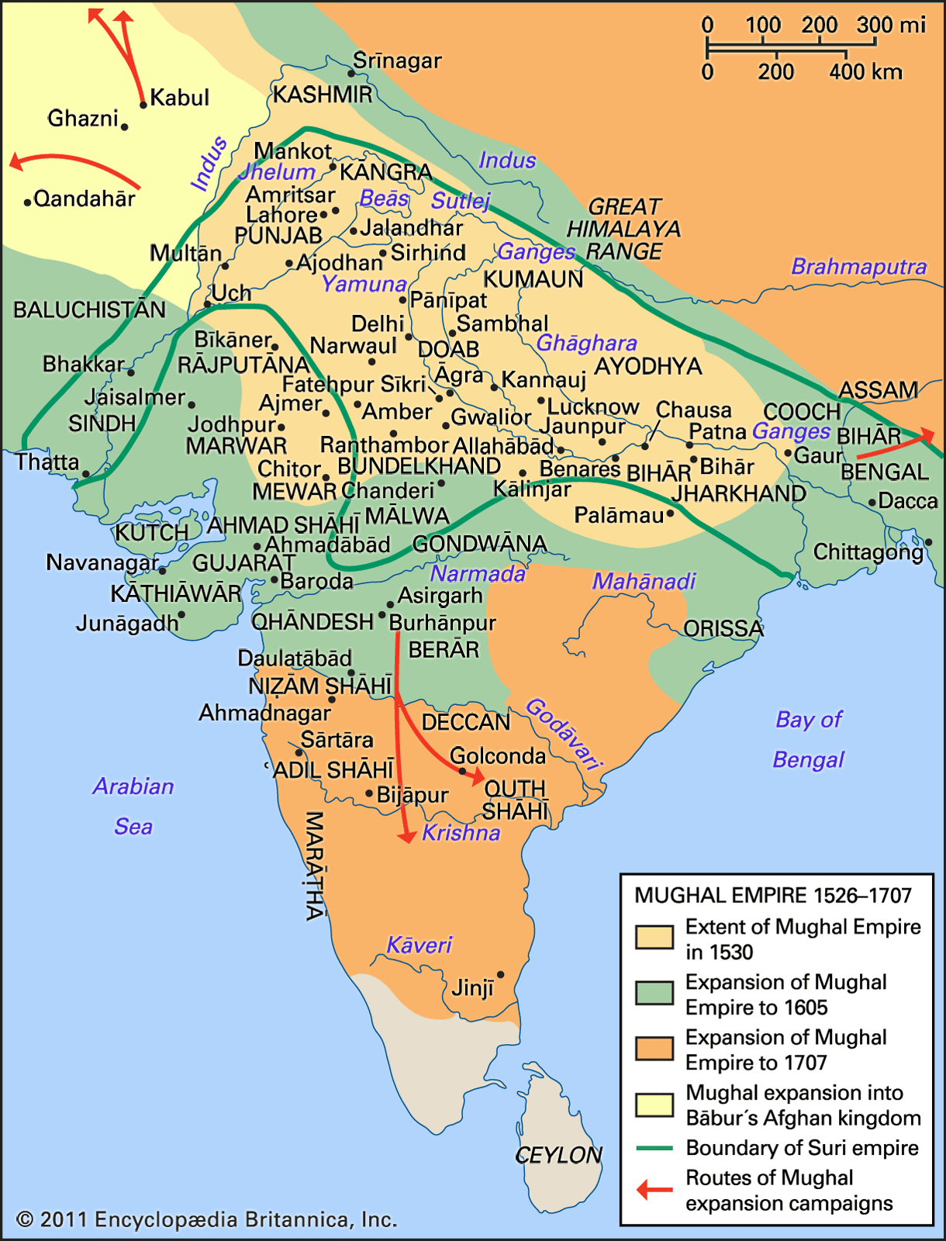

Slide 10
The beginning of European colonialism.
What is colonialism?
The term colonialism is derived from the Latin word colonus which means farmer.
Transfer of population from one territory to another, where the arrivals lived as permanent settlers while maintaining allegiance to country of origin.
It refers to how a country exercises power over other country whether through settlement, or indirect control.
However, the European colonialism differs from the earlier forms of colonialism to the advancement in the sailing ships. They colonized far off territories and colonized remote parts of the world.

Slide 11
The Portuguese and the Spanish had left the English and the Dutch far behind during the 15th century and the first half of the 16th century.
The reputedly fabulous wealth of India was an additional attraction as there was an acute shortage of gold all over Europe, and gold was essential as a medium of exchange if the trade was to grow unhampered.
In 1494, Columbus of Spain set out to reach India and discovered America instead of India.
In 1498, Vasco da Gama of Portugal discovered a new and all-sea route from Europe to India. He sailed around Africa via the Cape of Good Hope (South Africa) and reached Calicut.

Slide 12
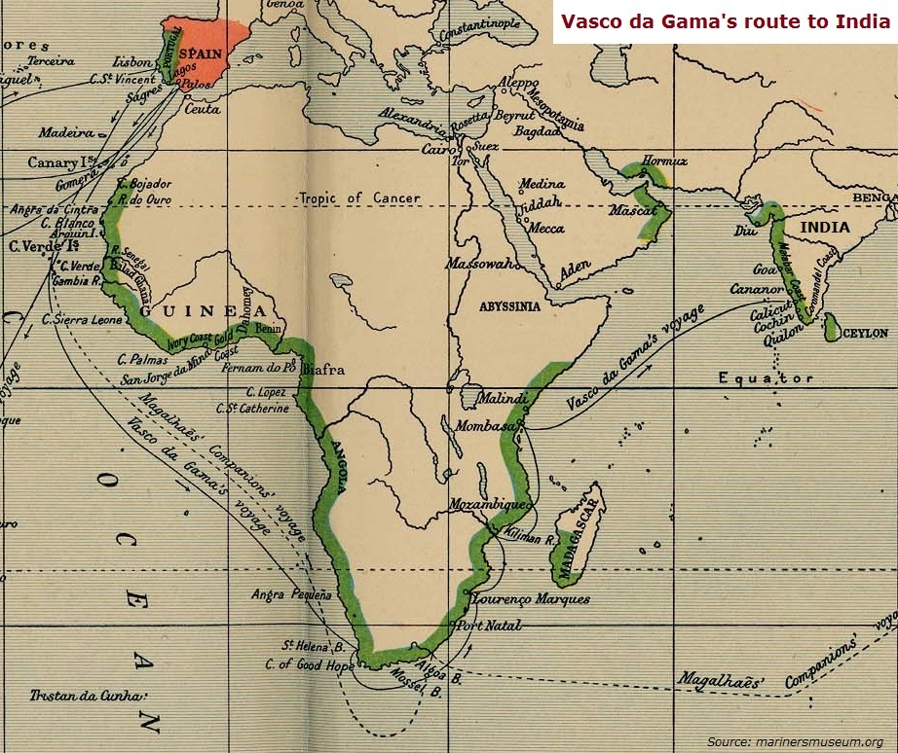

Slide 13
But, in the latter half of the 16th century, England and Holland, and later France, all growing commercial and naval, powers, waged a fierce struggle against the Spanish and Portuguese monopoly of world trade.
British East India Company and colonization of South Asia
An English association or company to trade with the East was formed in 1599 under the auspices of a group of merchants known as the Merchant Adventurers.
The company was granted a Royal Charter and the exclusive privilege to trade in the East by Queen Elizabeth on 31 December 1600. The company was named as the East India Company.

Slide 14
The East India company got permission from the Mughal court for doing trade in India.
The Mughal court allowed them to establish trade outposts in India due to the naval supremacy of the English over the Portuguese.
The Portuguese has established their trade outpost in South India due to which Mughals wanted to counter their influence through English.
By the end of the 17th century, the English Company was claiming full sovereignty over Madras and was ready to fight in, defense of the claim.
They also established fort called St. George in Madras From the very beginning, English Company of profit seeking merchants was also determined to make Indians pay for the conquest of their own country.

Slide 15
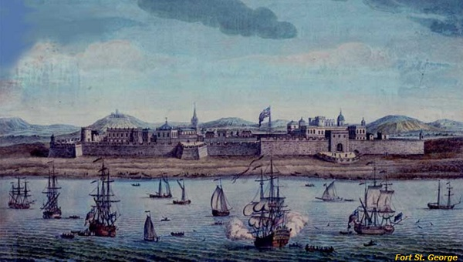

Slide 16
East India Company soon opened factories in Bengal and Bihar.
In 1686, English declared war against Mughals, but they have miscalculated the land power of the Mughals. Their factories and fort was seized by Mughals.
The British submitted petition to the Mughals and asked for pardon, Aurangzeb allowed them to do trade after levying with fine.
British settlements in Madras, Bombay, and Calcutta became the nuclei of flourishing cities.
the central authority had disappeared after the death of Aurangzeb (1707)
The French East India Company was founded in 1664. It made rapid progress and it was reorganized in the 1720's and soon began to catch up with the English Company.

Slide 17
For nearly 20 years from 1744 to 1763, the French and the English were to wage a bitter war for control over the trade, wealth, and territory of South Asia.
The beginning of the British political influence over India could be traced back to the fall of Siraj-ud-daula. In 1757, The British defeated the ruler of Bengal in the battle of Plassey and assumed the control of Bengal. Bengal was the most fertile and the richest of the Indian provinces.
The Mysore state was ruled by Haider Ali, Hyderabad state was ruled by Nizam, and Marathas ruled the regions adjoining the Delhi.
In 1766, British tried to make alliance with the Nizam of Hyderabad to attack Mysore. In 1775, The British also attacked Marathas to extend their control over the western regions of India. The war between the Marathas lasted from 1775-1782.

Slide 18
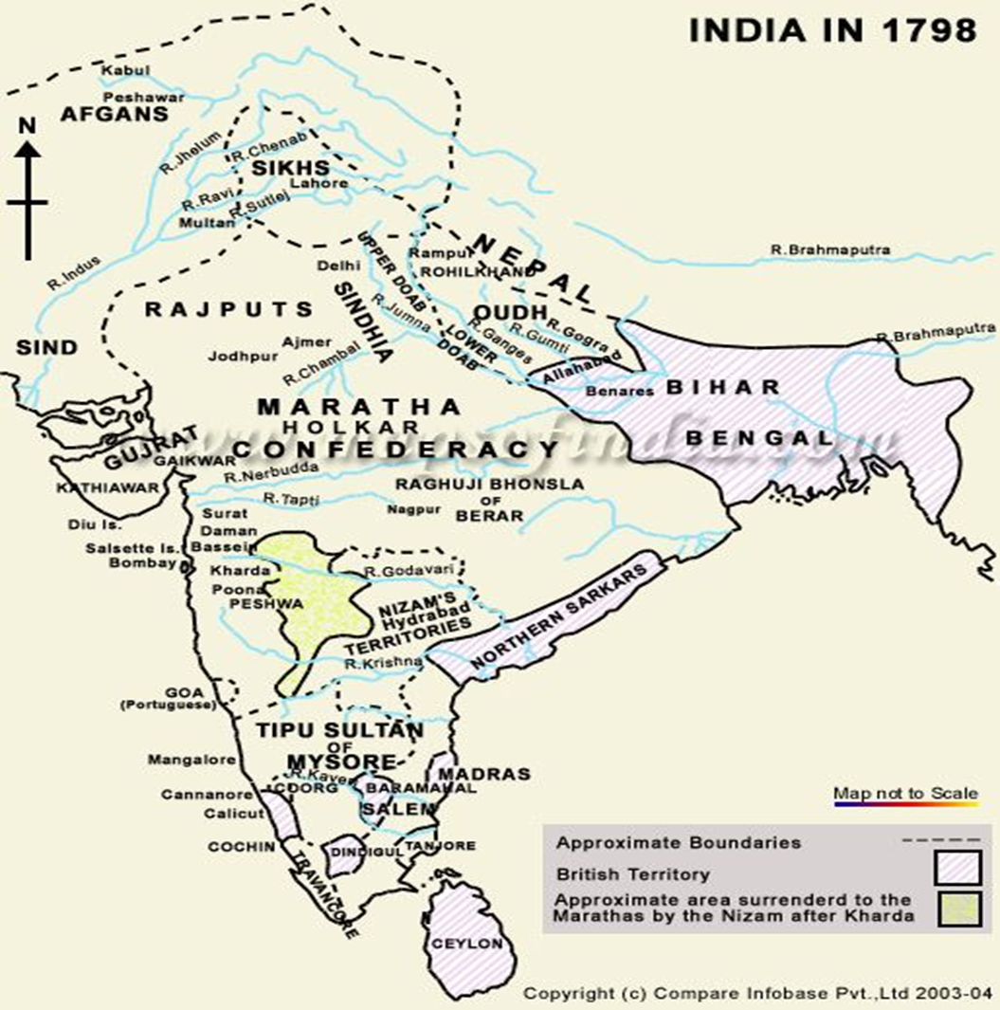

Slide 19
The Nizam, Haider Ali, and the Marathas formed a powerful alliance to counter the British policy of divide and rule. However, The British were successful in creating division between them. Haider Ali a.k.a Tipu sultan was left alone to fight the British. The war started between them and the British in 1789 and ended in 1792. Tipu Sultan was defeated, and Mysore was brought under the control of the British.
By the year 1818, all these states were brought under the control of the British East India Company. Only the region of Punjab and Sindh was not occupied by them. The region of Sindh and Punjab was important for countering the influence of Russia in the region. The importance of river Indus for the purpose of trade was also considered by the British East India Company.

Slide 20
The British defeated the Talpur rule in Sindh in 1843, and The Sikh rule in Punjab in 1849. However, the British rule was not uncontested in India. In 1857, the Indians rebelled against the British rule. But the British was successful in crushing the rebellion and establishing direct rule of Queen of Britain.

